Slide 1
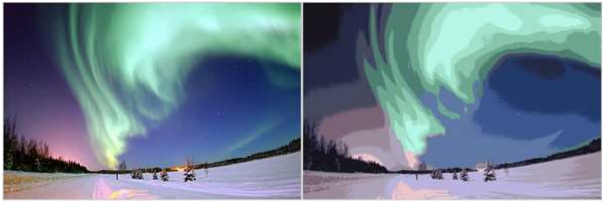
Image Segmentation
이성호, 설현수, 김수혁

Slide 2
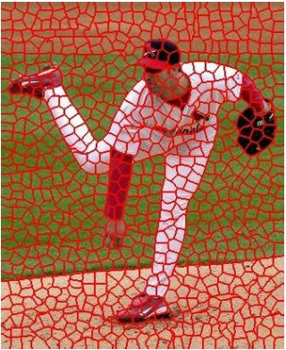
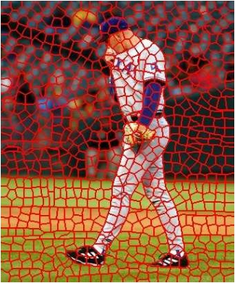
Goals of segmentation
- process of partitioning a digital image into multiple segments
- process of assigning a label to every pixel in an image such that pixels with
the same label share certain characteristics
• Group together similar-looking pixels for efficiency of further processing (simplify and/or change the representation of an image into something that is more meaningful and easier to analyze)
– “Bottom-up” process – Unsupervised
“superpixels”
X. Ren and J. Malik. Learning a classification model for segmentation. ICCV 2003.

Slide 3
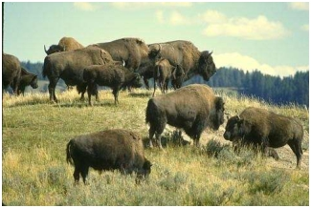
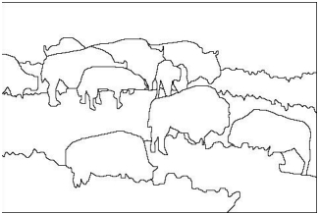
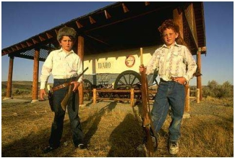
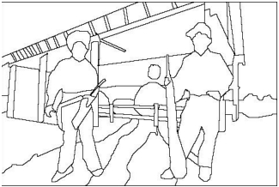
Goals of segmentation
• Separate image into coherent “objects” – “Bottom-up” or “top-down” process?
– Supervised or unsupervised?
image human segmentation
Berkeley segmentation database:
http://www.eecs.berkeley.edu/Research/Projects/CS/vision/grouping/segbench/

Slide 4
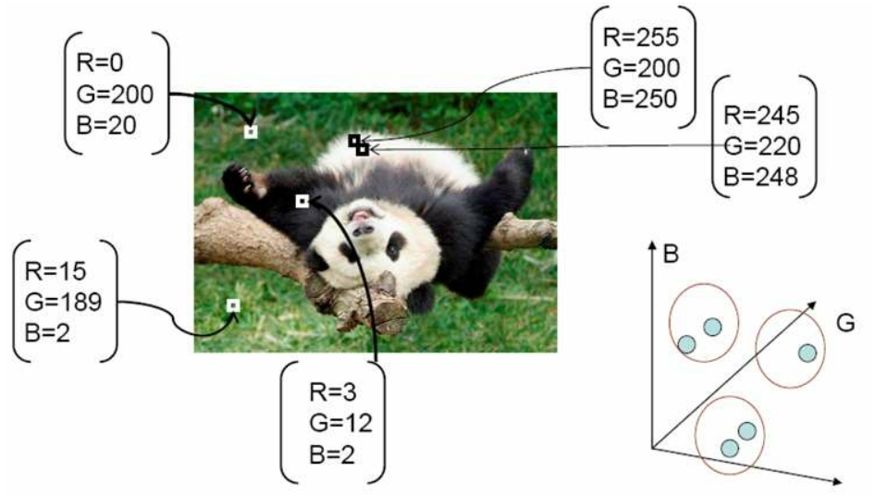
Segmentation as clustering
• Cluster similar pixels (features) together

Slide 5
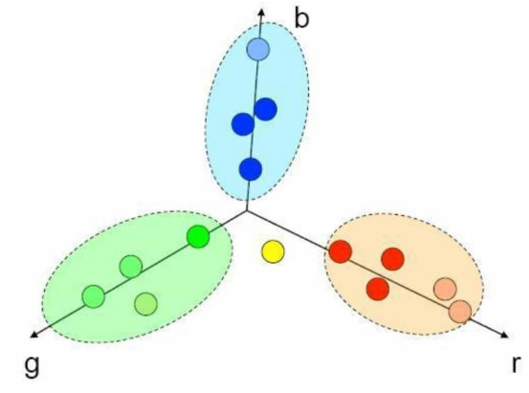
Segmentation as clustering
• Cluster together tokens with high similarity (small distance
in feature space)
Questions:
1. How many clusters?
2. Which data belongs to which group?

Slide 6
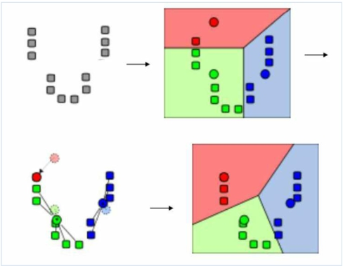
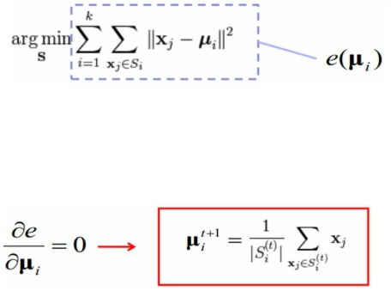
Segmentation as clustering
• K-means clustering
- Assign each of the N points, xj, to clusters by nearest μi
- Re-compute mean μi of each cluster from its member points - If no mean has changed more than some ε, stop
- solving the optimization problem
- Every iteration is a step of
gradient descent.

Slide 7
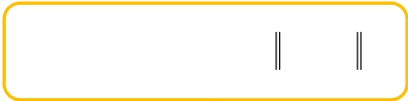
Segmentation as clustering
 
  
 j elements of i'th cluster
✓ ☒ ☑ 

iclusters
x j i
2
• K-means clustering
- an iterative technique that is used to partition an image into K
clusters
1. Pick K cluster centers, either randomly or based on some heuristic
2. Assign each pixel in the image to the cluster that minimizes the distance
between the pixel and the cluster center
3. Re-compute the cluster centers by averaging all of the pixels in the
cluster
4. Repeat steps 2 and 3 until convergence is attained (i.e. no pixels change
clusters)
- distance : the squared or absolute difference between a pixel and a cluster center ex. pixel color, intensity, texture, and location, or a weighted combination of these factors
- K can be selected manually, randomly, or by a heuristic.
- The quality of the solution depends on the initial set of clusters
and the value of K.

Slide 8
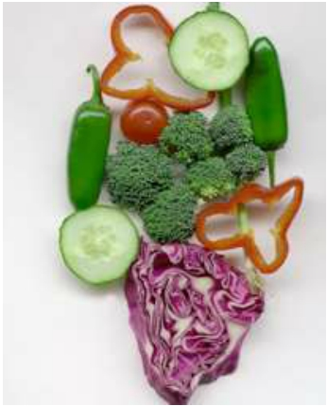
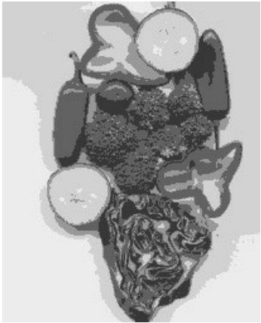
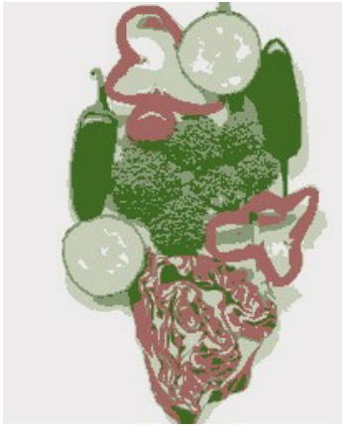
Segmentation as clustering
• K-means clustering based on intensity or color is essentially vector quantization of the image attributes. – Clusters don’t have to be spatially coherent.
Image Intensity-based clusters Color-based clusters

Slide 9
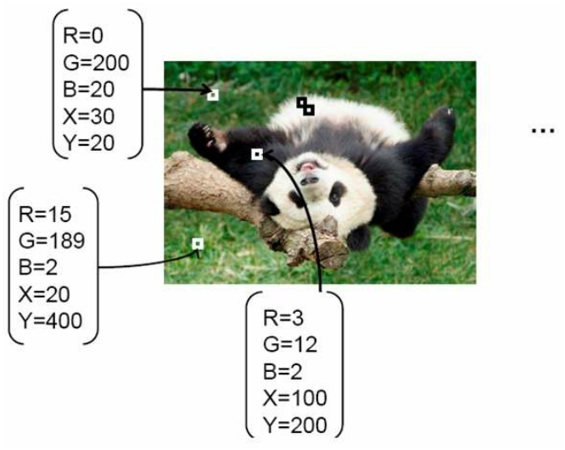
Segmentation as clustering
• Cluster similar pixels (features) together
→ Clustering based on (r, g, b, x, y) values enforces more
spatial coherence.

Slide 10
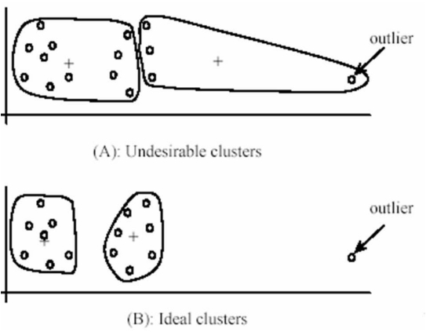
K-Means for segmentation
• Pros
– Very simple method
– Converges to a local minimum of the error function
• Cons
– Memory-intensive – Need to pick K
– Sensitive to initialization – Sensitive to outliers
– Only finds “spherical”
clusters

Slide 11
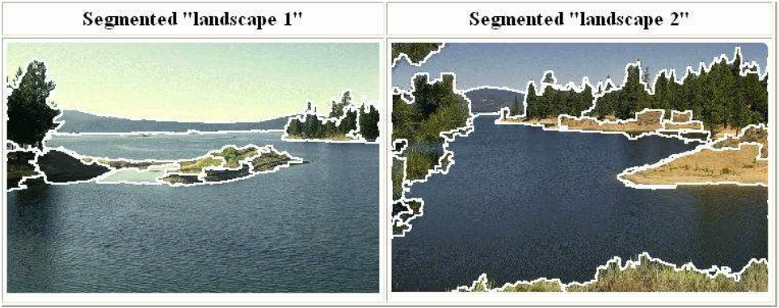
Mean shift clustering & segmentation
• An advanced and versatile technique for clustering-based
segmentation
http://www.caip.rutgers.edu/~comanici/MSPAMI/msPamiResults.html
D. Comaniciu and P. Meer, Mean Shift: A Robust Approach toward Feature Space Analysis, PAMI 2002.

Slide 12
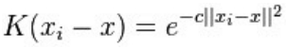
Mean shift algorithm
• a non-parametric feature-space analysis technique, a so-
called mode seeking algorithm
• Mean shift algorithm seeks modes or local maxima of
density in the feature space.
• a procedure for locating the maxima of a density function
given discrete data sampled from that function
• It is useful for detecting the modes of this density.
• an iterative method, and we start with an initial estimate x.
Let a kernel function K(xi - x) be given.
• This function determines the weight of nearby points for re-
estimation of the mean. Typically a Gaussian kernel on the
distance to the current estimate is used, .

Slide 13
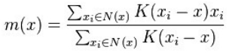
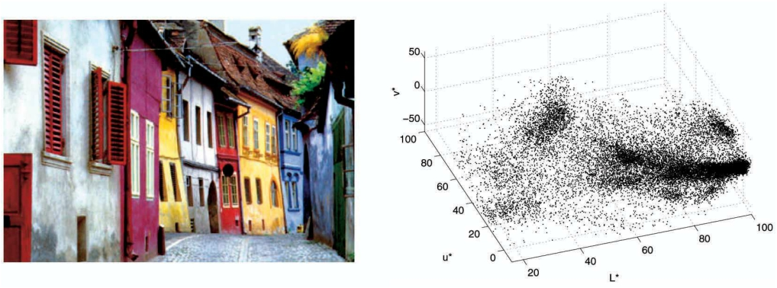
Mean shift algorithm
•
The weighted mean of the density in the window determined by is , where N(x) is the neighborhood of x.
•
The mean-shift algorithm now sets x ← m(x), and repeats the estimation until m(x) converges.
Feature space
(L*u*v* color values)
image

Slide 14
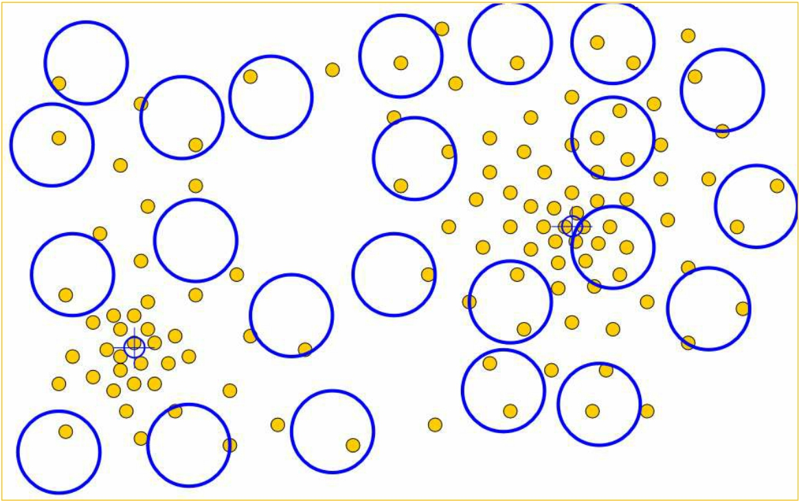
Mean shift
Slide by Y. Ukrainitz & B. Sarel

Slide 15
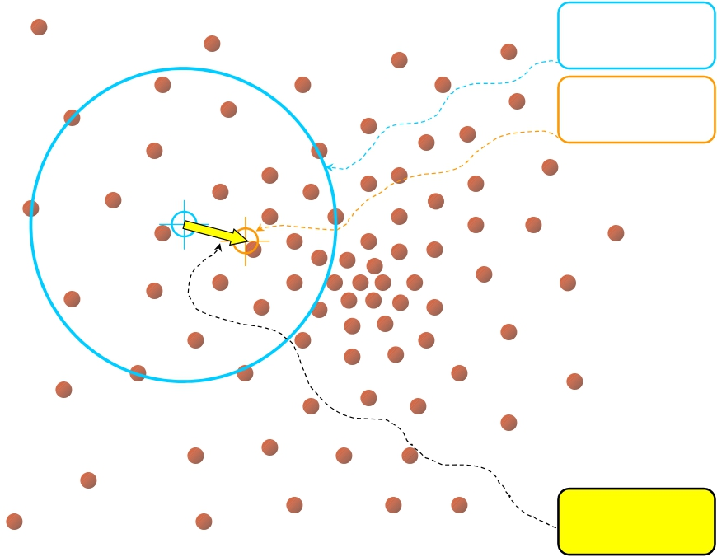


Mean shift
Search
window
Center of
mass
Mean Shift
vector
Slide by Y. Ukrainitz & B. Sarel

Slide 16
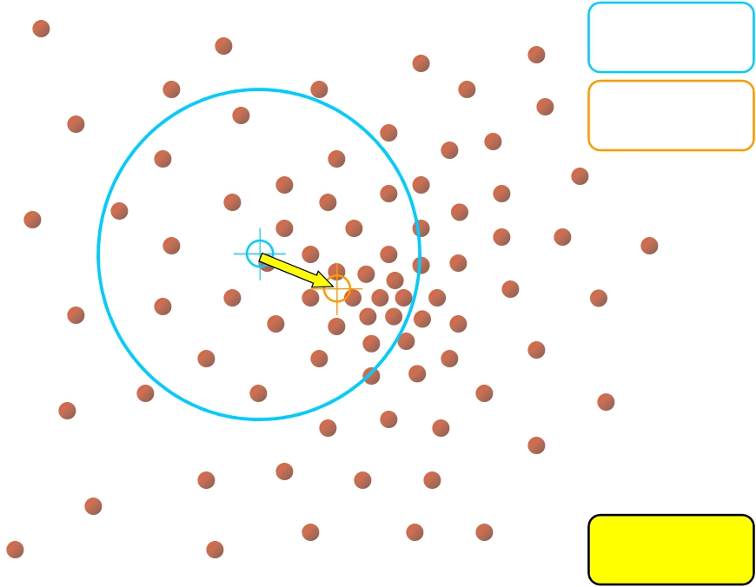
Mean shift
Search
window
Center of
mass
Mean Shift
vector
Slide by Y. Ukrainitz & B. Sarel

Slide 17
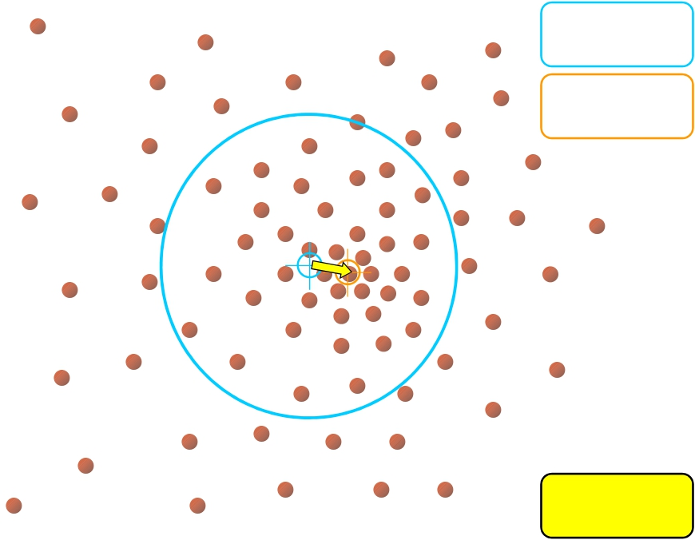
Mean shift
Search
window
Center of
mass
Mean Shift
vector
Slide by Y. Ukrainitz & B. Sarel

Slide 18
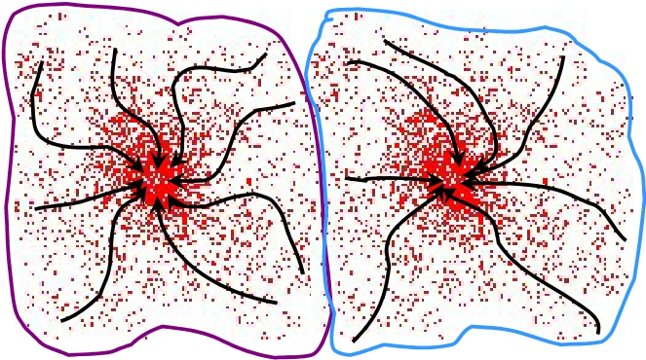
Mean shift clustering
• Cluster : all data points in the attraction basin of a mode
• Attraction basin : the region for which all trajectories lead to
the same mode
Slide by Y. Ukrainitz & B. Sarel

Slide 19
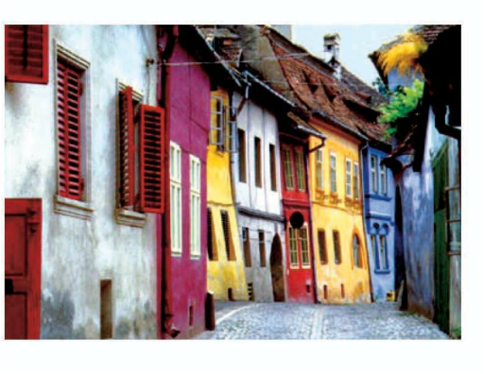
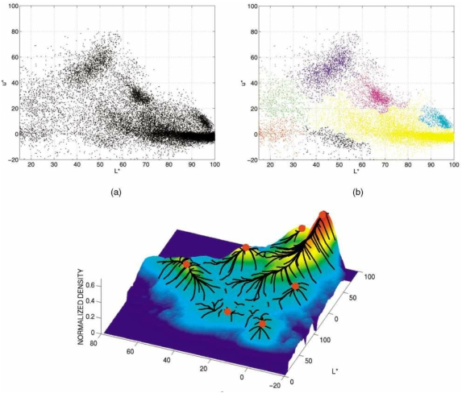
Mean shift clustering/segmentation
• Find features (color, gradients, texture, etc).
• Initialize windows at individual feature points.
• Perform mean shift for each window until convergence.
• Merge windows that end up near the same “peak” or mode.
http://darkpgmr.tistory.com/64

Slide 20
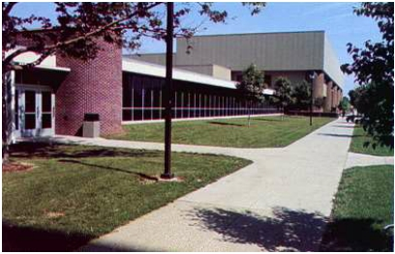
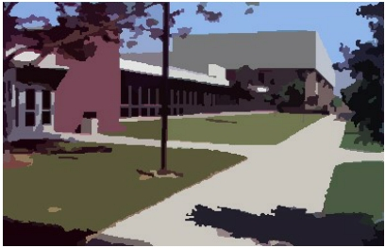
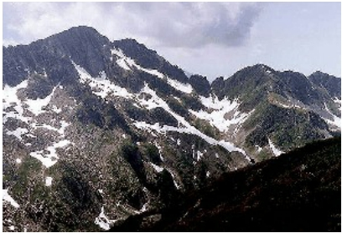
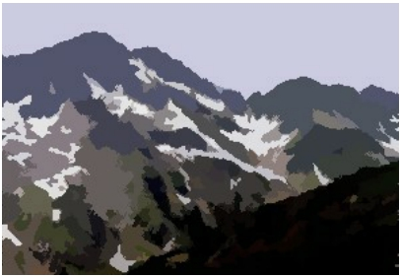
Mean shift segmentation results
http://www.caip.rutgers.edu/~comanici/MSPAMI/msPamiResults.html

Slide 21
Mean shift
• Pros
– Does not assume spherical clusters.
– Just a single parameter (window size). – Finds variable number of modes.
– Robust to outliers
• Cons
– Output depends on window size.
– Computationally expensive
– Does not scale well with dimension of feature space.

Slide 22
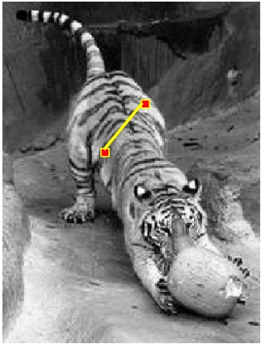
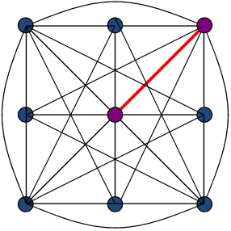
Images as graphs
j
i wij
• Node for every pixel
• Edge between every pair of pixels (or every pair of
“sufficiently close” pixels)
• Each edge is weighted by the affinity or similarity of the two
nodes

Slide 23
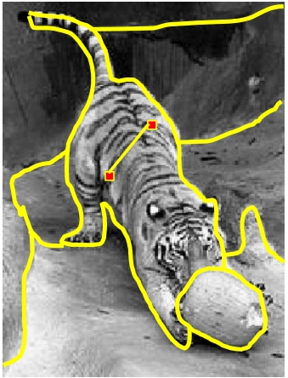
Segmentation by graph partitioning
j
i wij
A B C
• Break graph into segments
– Delete links that cross between segments
– Easiest to break links that have low affinity
✓ Similar pixels should be in the same segments.
✓ Dissimilar pixels should be in different segments.

Slide 24
Measuring affinity
• Suppose we represent each pixel by a feature vector x, and define a distance function appropriate for this feature representation
• Then we can convert the distance between two feature
vectors into an affinity with the help of a generalized
Gaussian kernel:

exp


1
22
−
dist
(xi
,
x
)
2
j
• Scale affects affinity
- Small σ: group only nearby points - Large σ: group far-away points

Slide 25
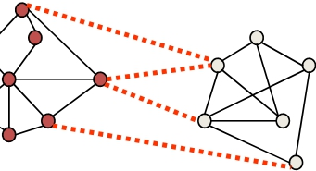
Graph cut
A B
• Set of edges whose removal makes a graph disconnected
• Cost of a cut: sum of weights of cut edges
• A graph cut gives us a segmentation.
– What is a “good” graph cut and how do we find one?

Slide 26
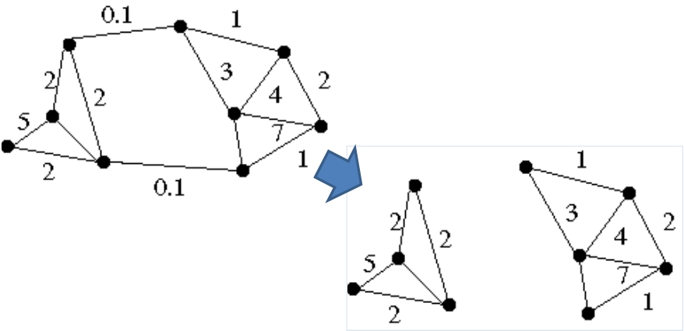
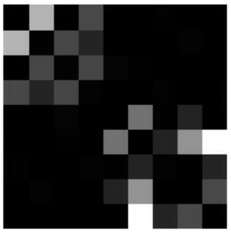
Minimum cut
•
We can do segmentation by finding the minimum cut in a graph.
– Efficient algorithms exist for doing this
Minimum cut example

